Slide 1
A Presentation
By
Chinazom Jennifer Okoli
On
Bike Sales Analysis
19th Sept.,2023.

Slide 2

Outline;
Introduction
What our Dataset looks like before cleaning
Data Cleaning
What our Dataset looks like after cleaning
Creating Pivot Table
Findings
Creating Dashboard
Inserting Slicers
Image of our Dashboard
Conclusion.

Slide 3
Introduction
The Dataset shows Bike Sales Data with the following columns; ID, Marital status Gender, Income, Children, Education, Occupation, Home Owner, Cars, Commute Distance, Region, Age and Purchased Bike.
The objective is to explore the relationship between some of the columns with bike sales.
Aims at identifying patterns and trends that may influence sales performance and provide insights into target markets.
This will help tailor marketing strategies accordingly and help make informed decision on the following basis;

Slide 4
Market Research - To understand how price sensitivity affects purchasing decisions.
Demand Forecasting – Purchase likelihood based on demographic and socioeconomic attributes.
Customer Segmentation – To segment customers into different groups based on their characteristics. This segmentation can provide insights into target markets.
Sales Performance Analysis - To identify patterns and trends that may influence sales performance.

Slide 5
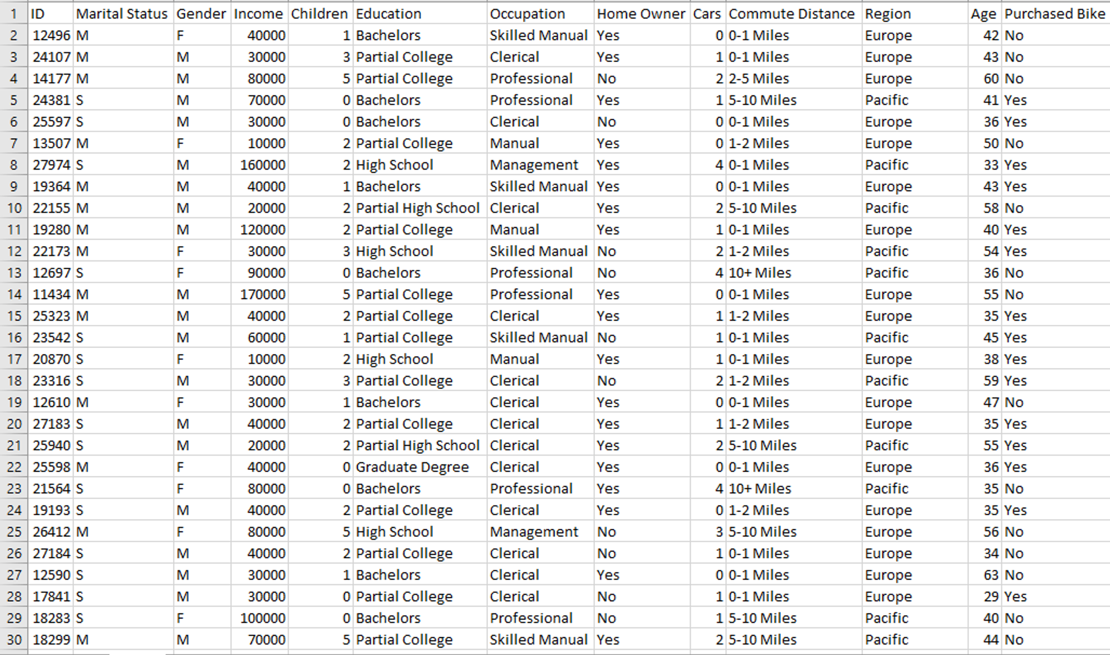

Slide 6

Data Cleaning
The dataset comprises of 14 columns and 1027 rows.
Remove Duplicate
Filter
Find and Replace
Format Change
Creating another Column named “Age Brackets” –Using Nested IF
=IF(L2>54,"Old",IF(L2>=31,"Middle age",IF(L2<31,"Adolescent")))
“L2” is the cell name of the first row in column “Age”.

Slide 7
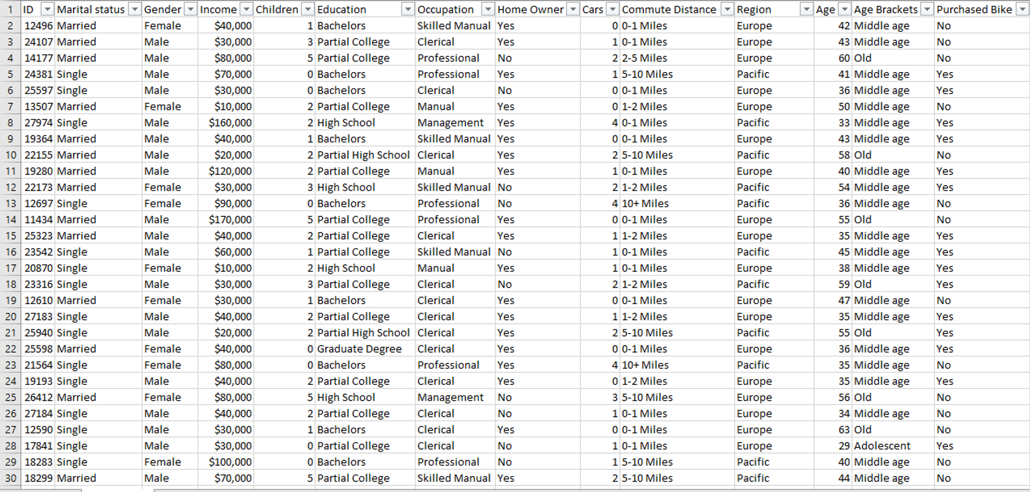

Slide 8
Creating Pivot Table
Open a new spreadsheet, rename it Pivot Table
Click on the “Insert” tab and select Pivot Table
To select the Table/Range, open the spreadsheet that contains your data and select the Table
The column headers appears on the pivot table fields. Here we can drag the different fields to either of the following areas; Column, Row, Value or Filter depending on your findings.

Slide 9
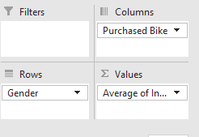
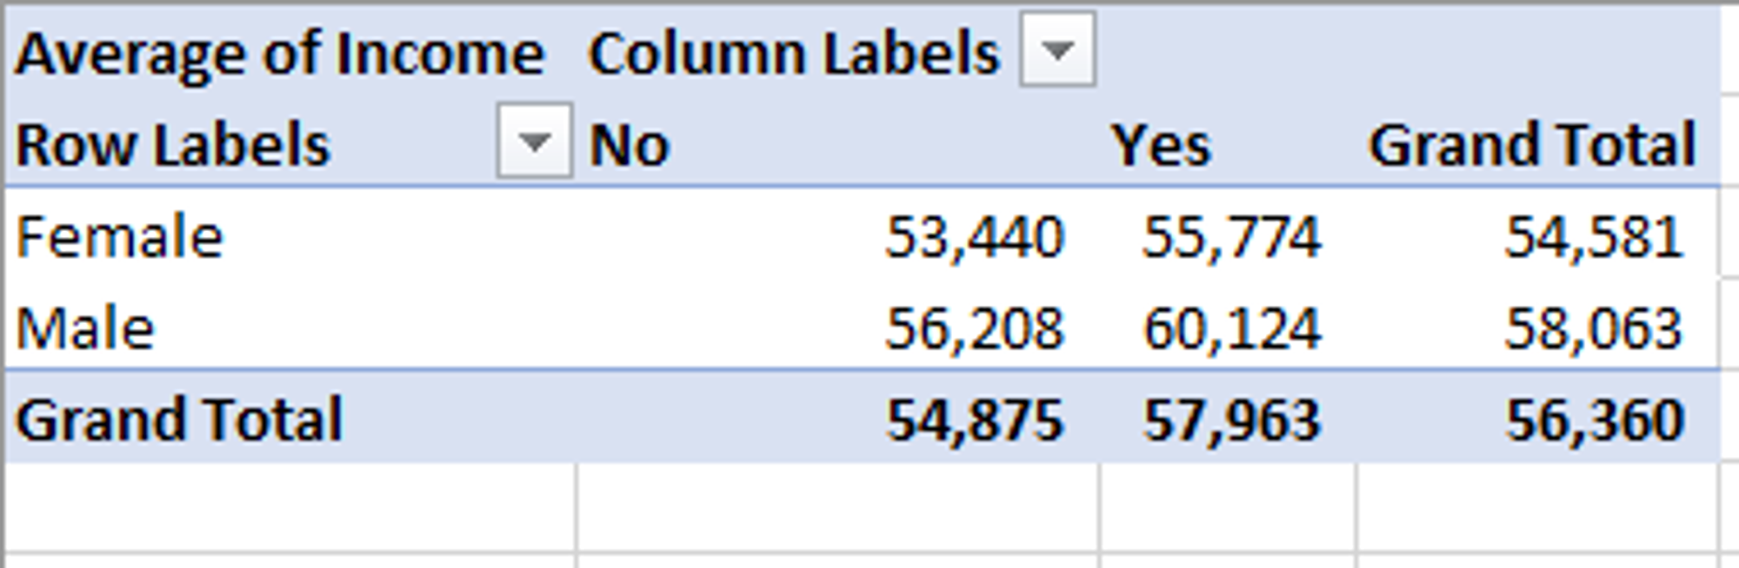
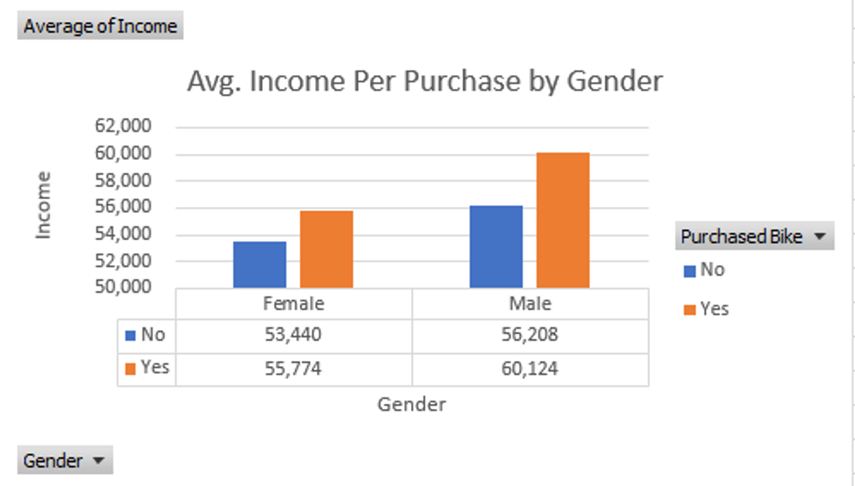
Findings;
1. Average Income of Males and Females who purchased and did not purchase bikes:

Slide 10
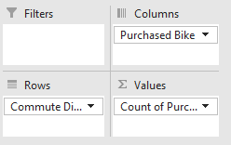
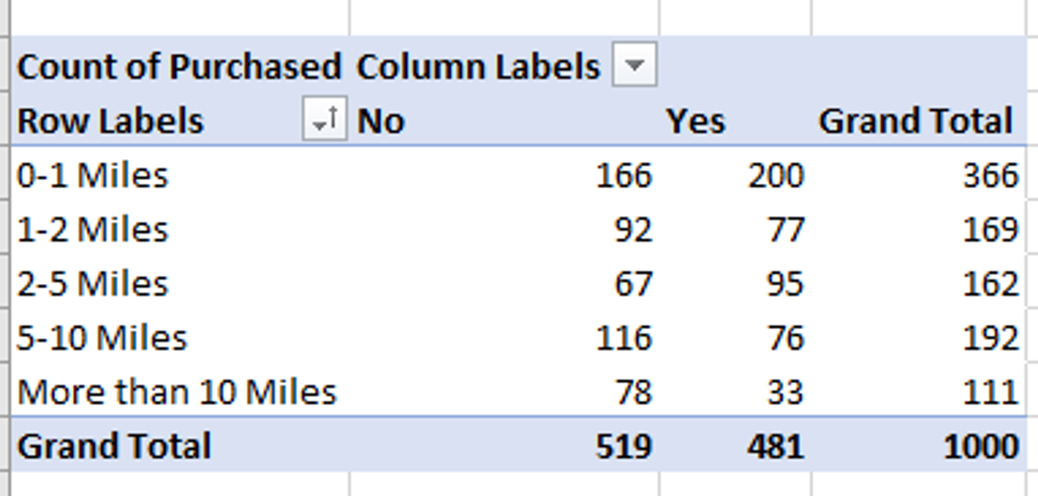
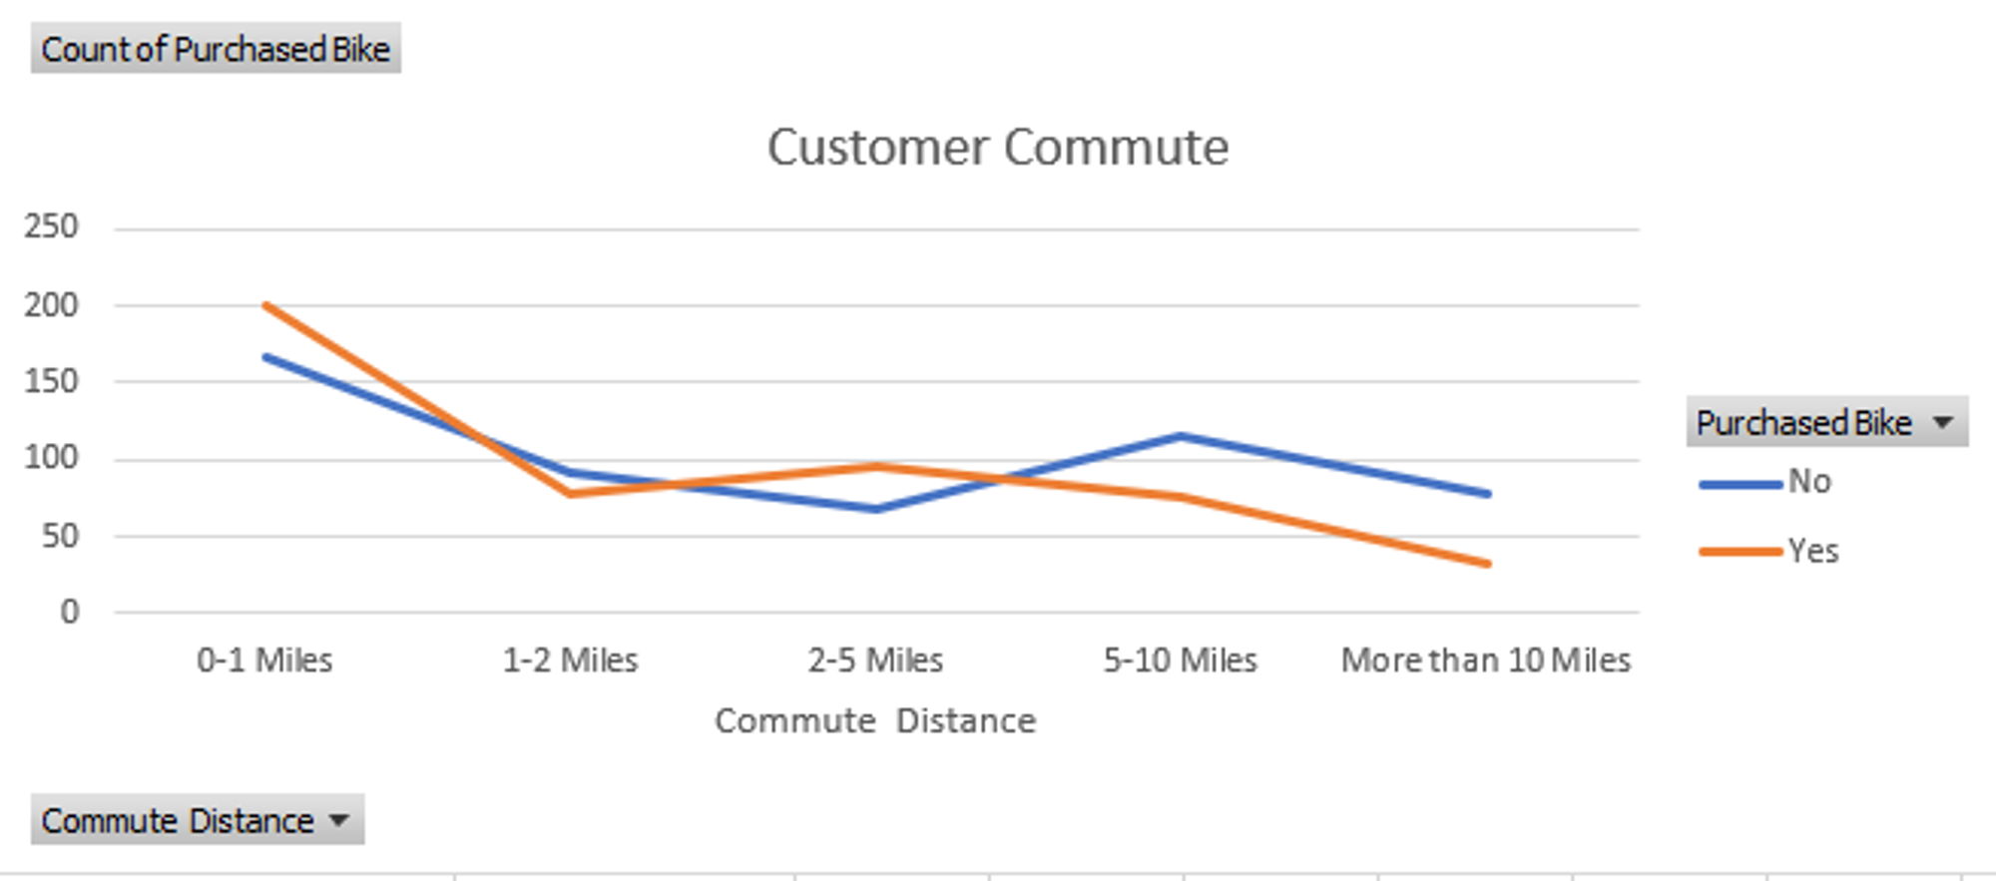
2. Commute Distance vs Bike purchased: The effect of commute distance on bike purchase;

Slide 11
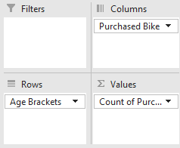
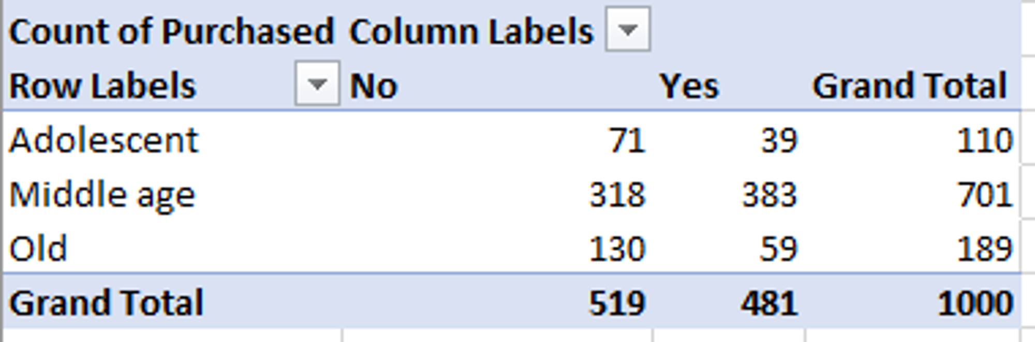
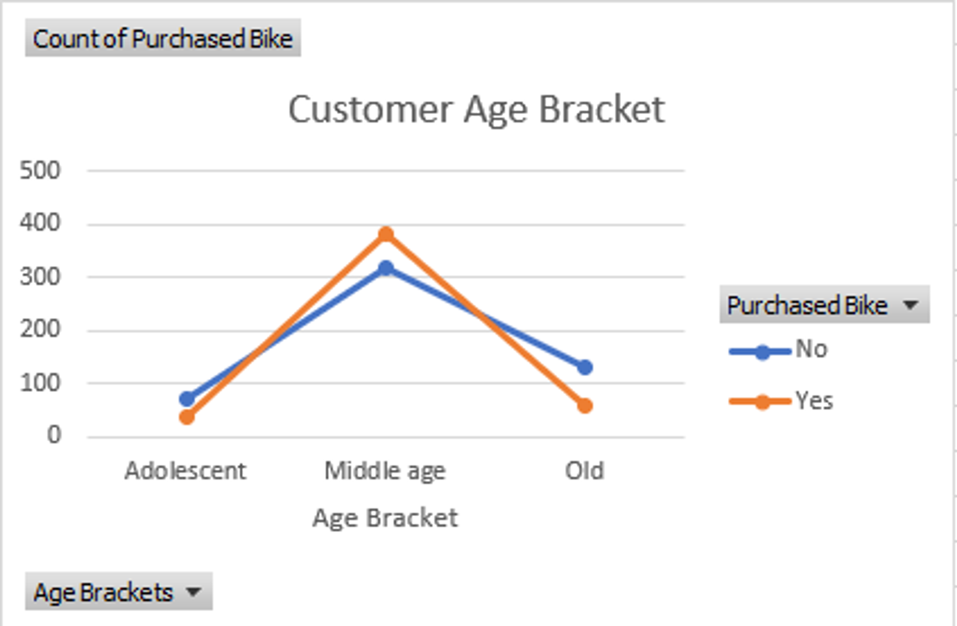
3. Bike purchased per age bracket: To analyse which Age Bracket bought the most bikes.

Slide 12
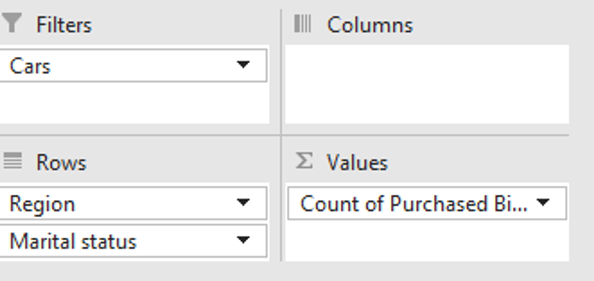
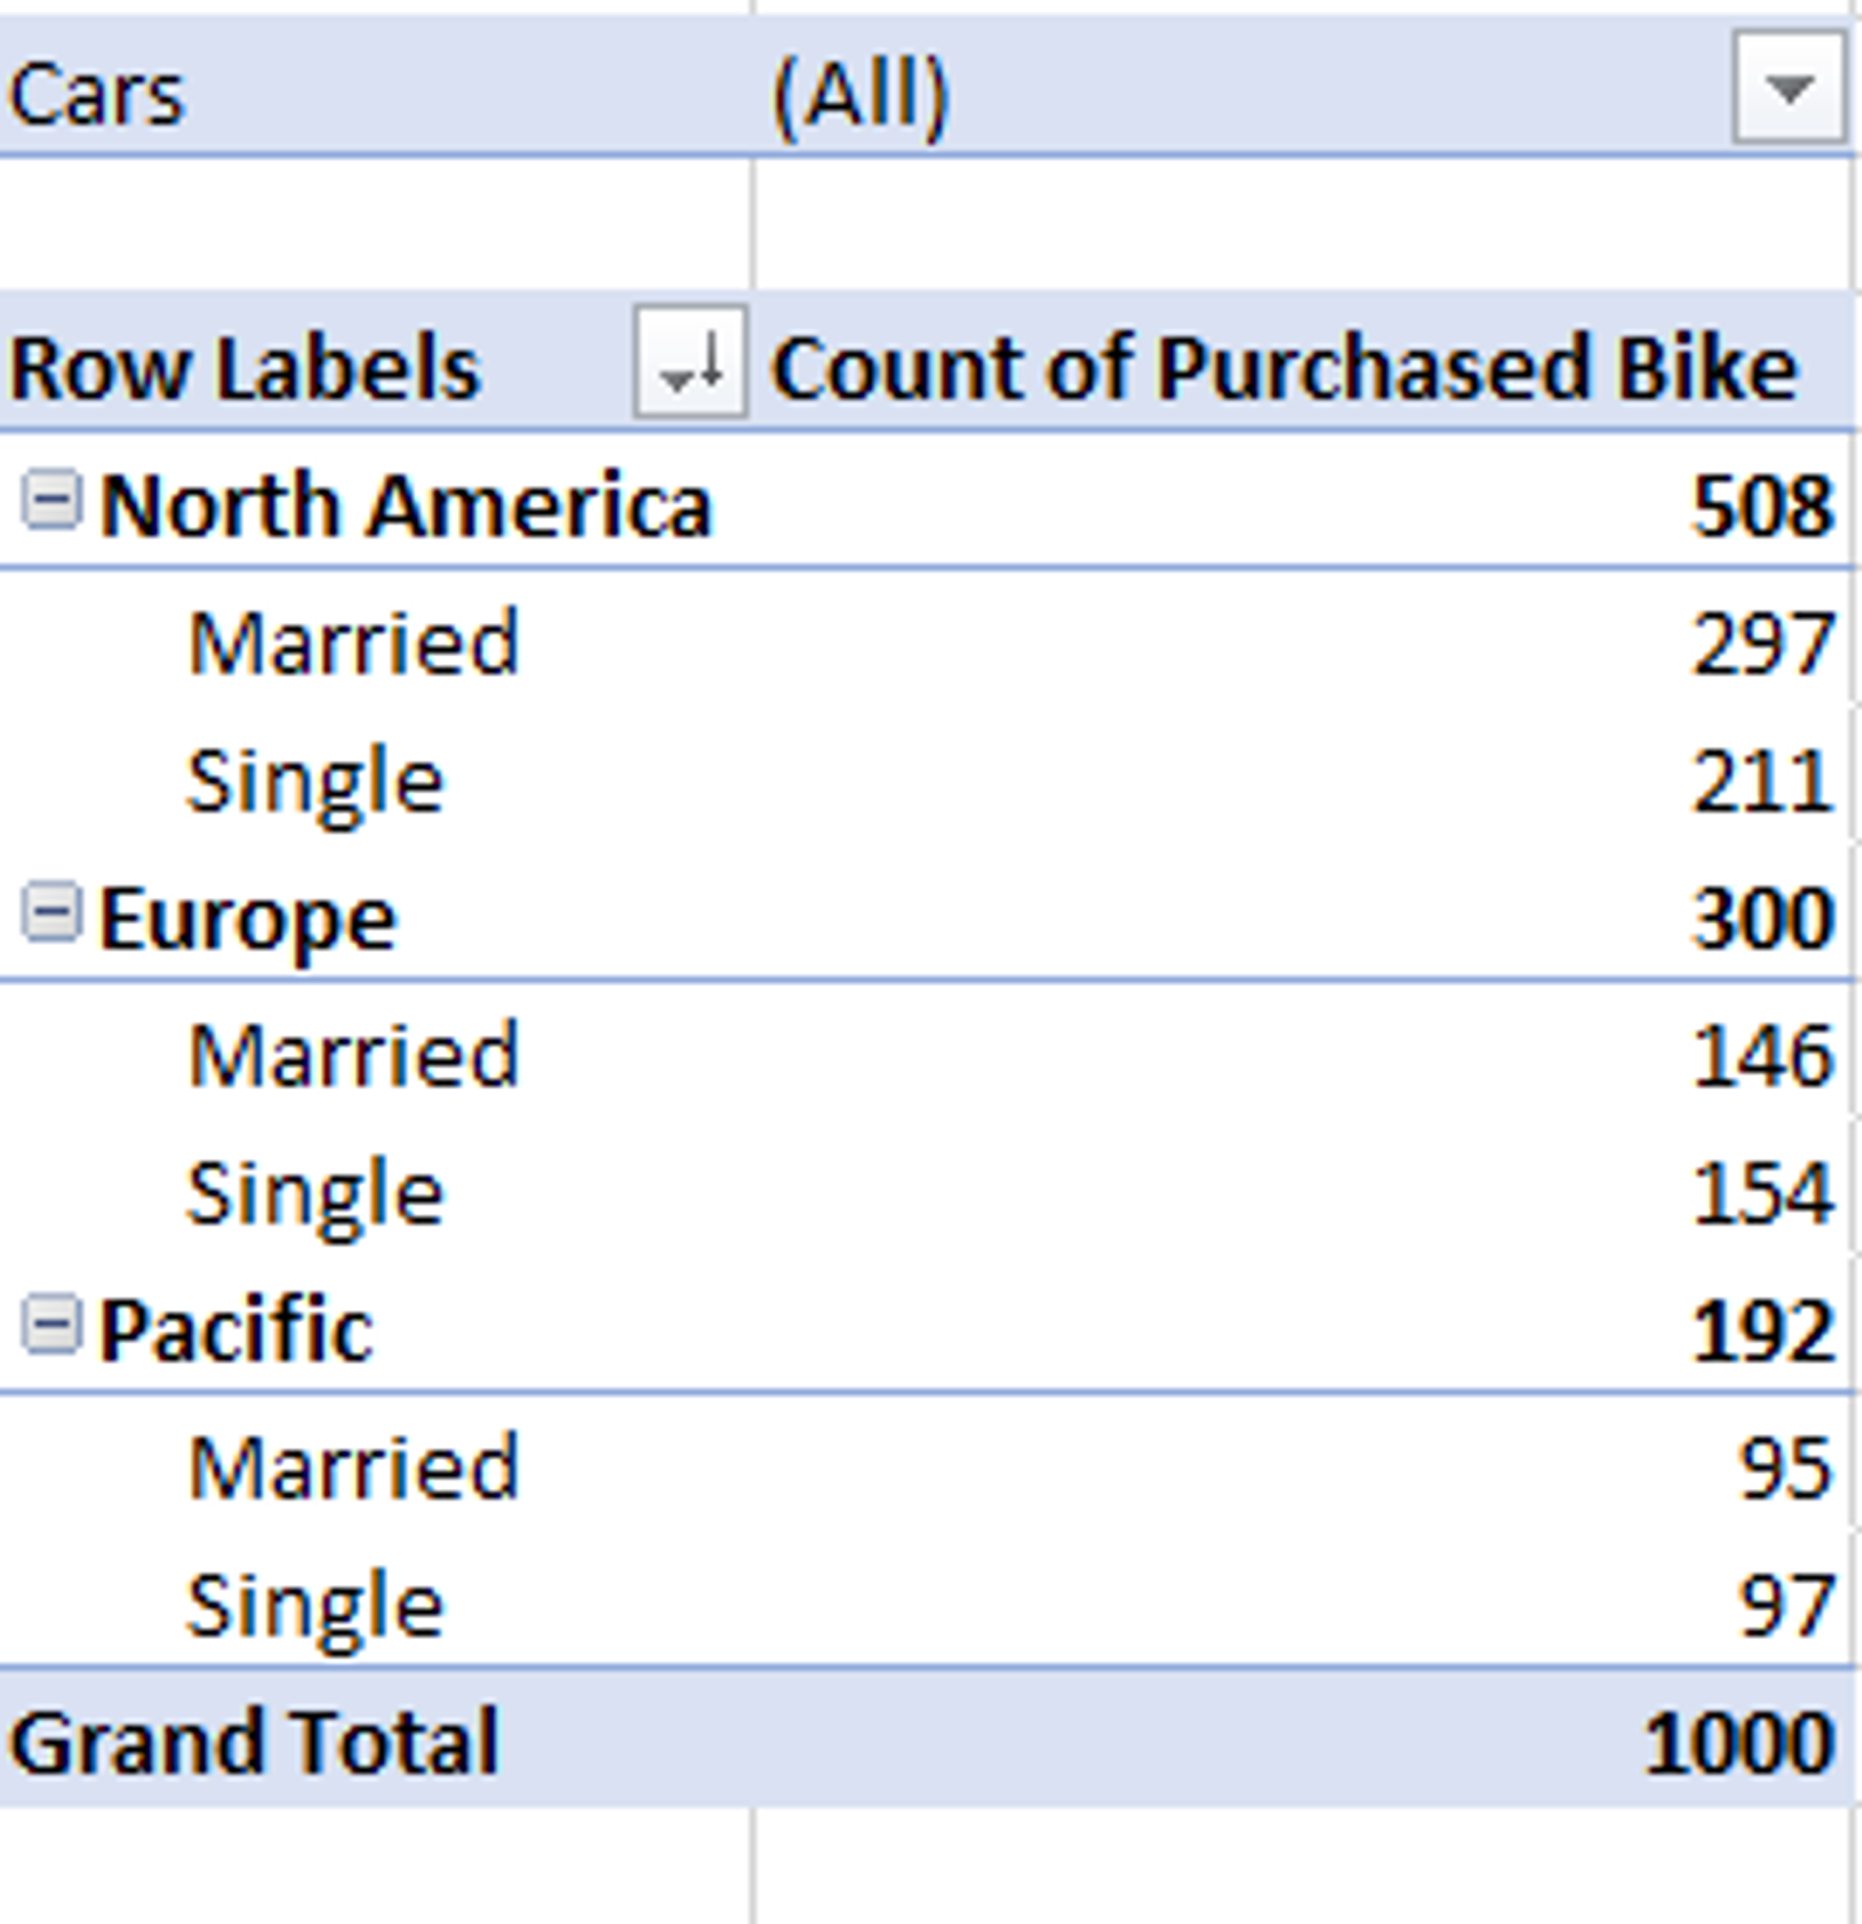
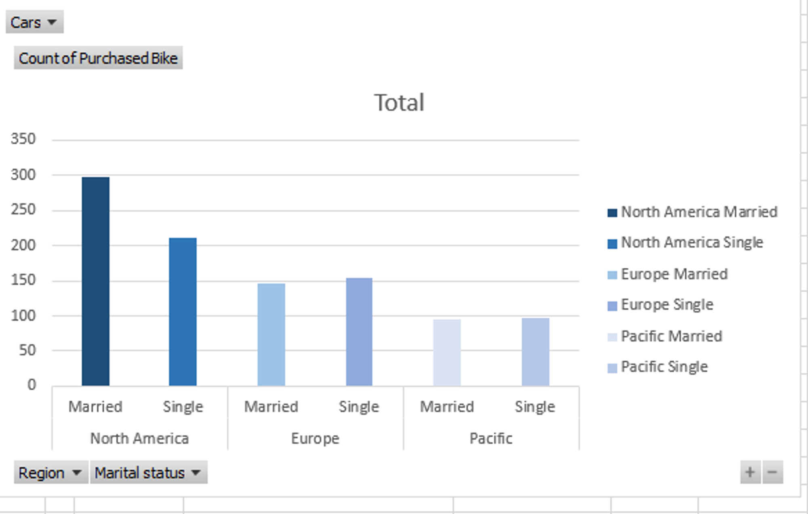
4. Count of Purchased Bikes by Region and Marital Status, The data is further filtered by Cars;

Slide 13
Creating Dashboard
Steps;
Open a New Spreadsheet
Select “View” tab
Untick the “Gridlines”
A Dashboard header was created by clicking on the “Insert” tab, select “Text box” from the “Text” command,
Used the cursor to create enough space for the header,
Coloured the header with blue using the Colour Fill
Named the Header, coloured the text white
Copied and Pasted my Pivot Charts, one at a time
Aligned them with my cursor.

Slide 14
Inserting Slicers
Slicers - Visual filter added to pivot tables and pivot charts in Excel. Allows filtering data quickly and easily, making it simple to understand what data is currently displayed.
Clicked on the “PivotChartAnalyze” Tab, then on “Insert Slicers” and selected some of the column heads.
Using my cursor, I arranged the slicers by the side of my charts.
To connect each slicer to all the Pivot Charts;
Clicked on the slicer which causes a “Slicer” tab to appear, clicked on it then on “Report connections”. Ticked all the Pivot Table listed.

Slide 15
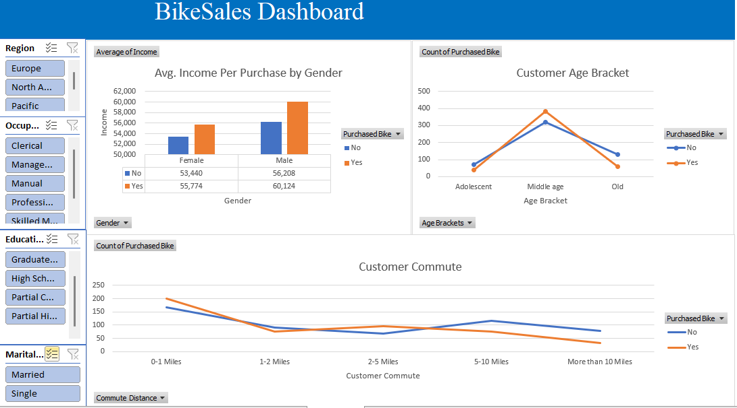

Slide 16
Conclusion
From the above analysed Data;
Table 1 - Average Income of Individuals who purchased bikes is higher. Male has higher Average Income than the Females, also bought more bikes than them.
Table 2 - Commute Distance vs Bike Purchased
0-1 Miles has the highest purchase followed by 2-5Miles while 10+ miles has the least purchase. 0-1Miles also has the highest number of no purchase followed by 5-10Miles.
Table 3 - Bike Purchased Per Age Bracket:
The Middle age group (31 -54) bought more bikes followed by the Old group (55+) with a wide range of over 200. The Old and Adolescent (30 and below) fall in the “No” category than they do in the “Yes”.

Slide 17
Table 4 - Count of Purchase by Region and Marital Status, filtered by Cars:
More purchases were made in North America, followed by Europe then Pacific. Married folks made more purchase than the Single overall, though in Europe and Pacific, Single made more purchases by a few than the Married while in North America, the reverse was the case.
Individuals with 2 cars made the highest purchase followed by 1 car then No car on a close range. People with 4 cars made the least purchase.
The Males, People that commune within 0-1Mile, the Middle age, the Married and North America made more purchases than their cohorts, though the differences in some wasn't much.

Slide 18

THANK
YOU.

